Slide 1
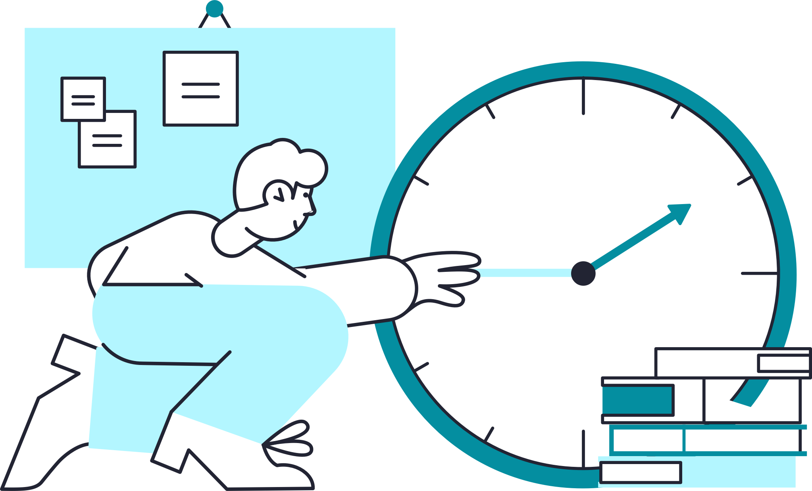
Beanstack Teacher Training
Updated March 2023

Slide 2
Agenda
What is Beanstack?
Reader Experience + Main Features
New Features
Teacher Experience
Help + Resources

Slide 3
Beanstack’s Mission
Instead of a quiz-based approach, Beanstack uses competition, recognition, and proven gamification principles to motivate students to read and grow your school’s reading culture.

Slide 4
Why we’re using Beanstack at Glenn Hills High School?
Beanstack is a reading motivational platform. It has been purchased by the Richmond County School System to encourage students to build a habit of reading and to increase reading stamina.

Slide 5
What is Beanstack?

Slide 6
Student Experience + Features

Slide 7
How do users access Beanstack?
Signing in
Users sign in through the district’s Single Sign On (SSO) provider, e.g, Classlink or Clever OR
Users navigate directly to the school’s Beanstack site, e.g., Google SSO
Roster sync
Automatic: Classlink and Clever
Manual: CSV and Google

Slide 8
Key Features
Logging reading and earning badges
Completing activities
Writing reviews
Streaks
Reading log (‘virtual bookshelf’)
Friends + Leaderboards

Slide 9
Mobile App
Reader view only (no admin functionality)
Progress made on the mobile app will be reflected on the web, and vice versa — it’s one account with two access points
Easily sign in with SSO, including ClassLink, Clever, and Google!

Slide 10
Challenge Calendar
Turn-key reading challenges automatically activated on your site
High quality content for every month of the year
Access to customizable promotional materials and all challenge artwork assets

Slide 11
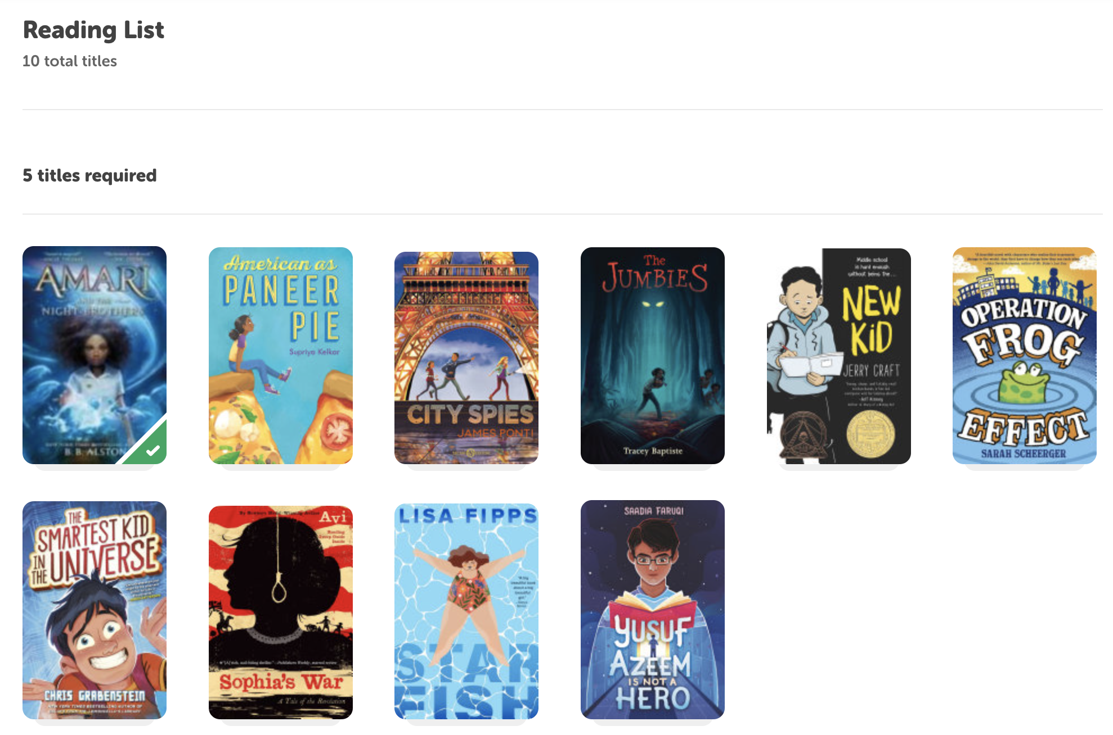
Reading List Challenges
Reward readers for logging and finishing specific titles
Create your own reading list challenge or use a template
Up to 30 titles
Use for state book awards, ELA curriculum, librarian recommendations and more!
Link directly to your ebook platform

Slide 12
Short Stacks
Beanstack original content
Type of Reading List challenge
Short, high-interest nonfiction articles accessible right in the Beanstack app
Curriculum aligned educator guides and easy to follow lesson plans

Slide 13
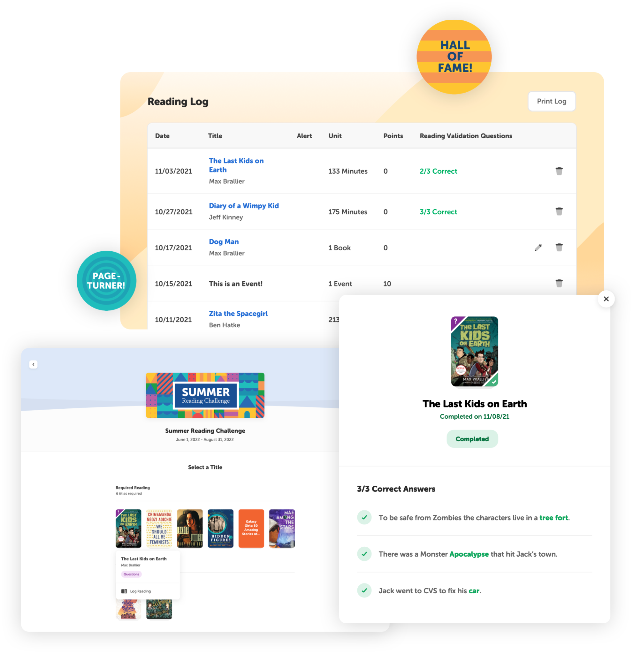
Reading Validation
Helps ensure reading accountability
Verify student reading with 3 simple comprehension questions
Available for 2000+ titles at the elementary and secondary levels
Multiple attempts to answer questions (no lockouts!)

Slide 14
Student Experience Demo

Slide 15
Teacher Experience

Slide 16
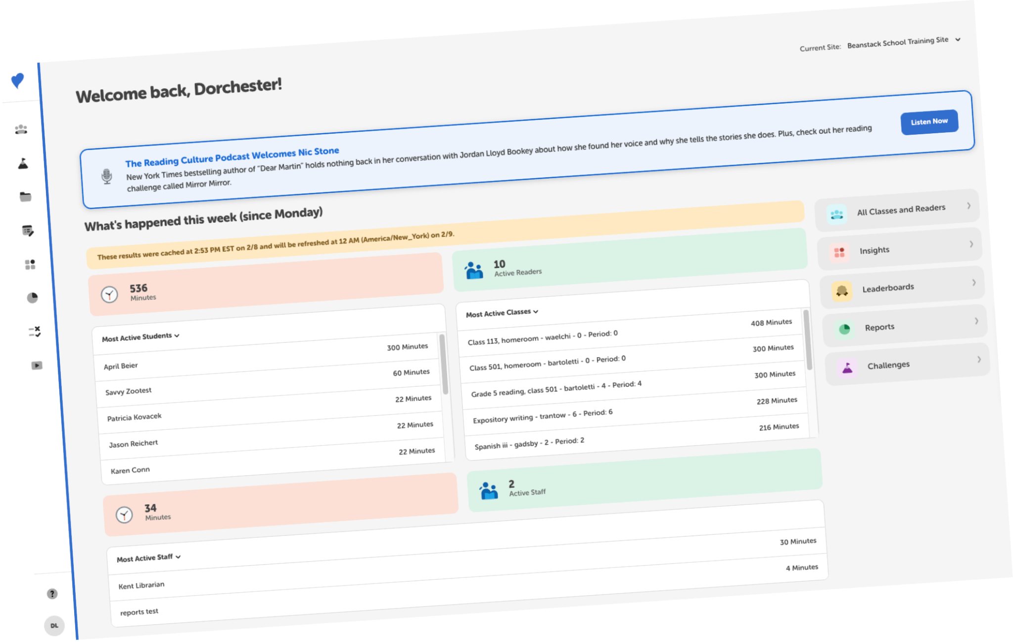
Teacher Dashboard
Key reading engagement metrics for the current week
Sorting options quickly reveal top readers and unengaged readers
Teachers can log for classes right from dashboard
Quick access to most-used sections

Slide 17
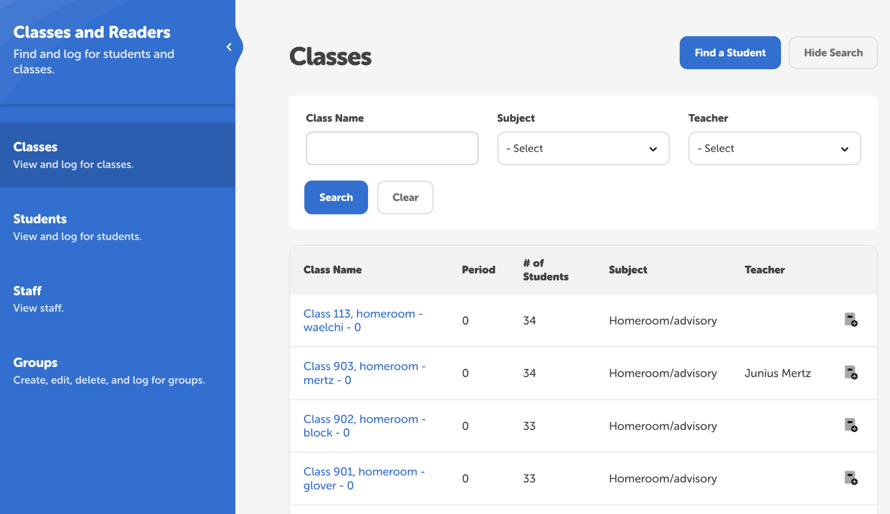
Assist Students + Classes
In the Classes and Readers tab
Monitor student logs, challenge progress, and take action for specific students
Bulk log reading for an entire class of students

Slide 18
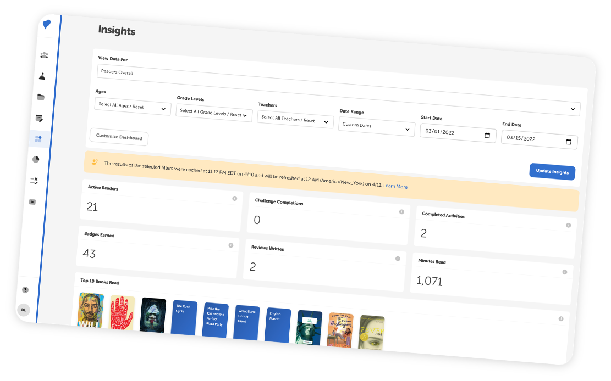
Insights
Quick at-a-glance snapshot of reading data for your classes
View key statistics like minutes read, top books logged, reviews written, and more
Use for overall class statistics

Slide 19
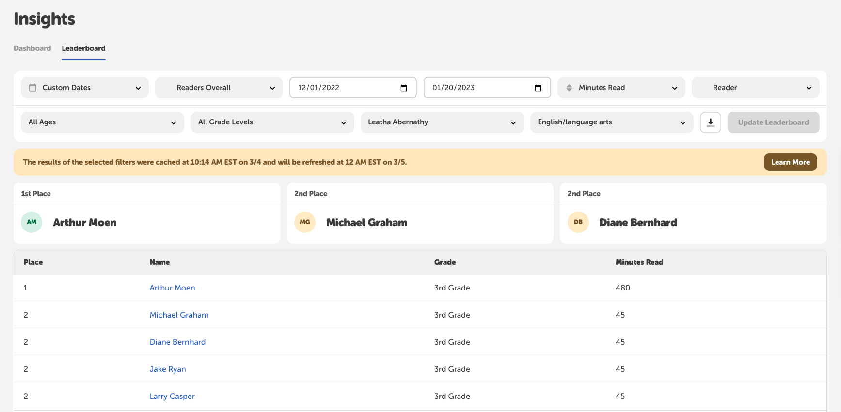
Leaderboards
Quickly view top readers or top classes
Use to run classroom competitions or just for your own knowledge
View data for the week, specific challenges, or custom dates

Slide 20
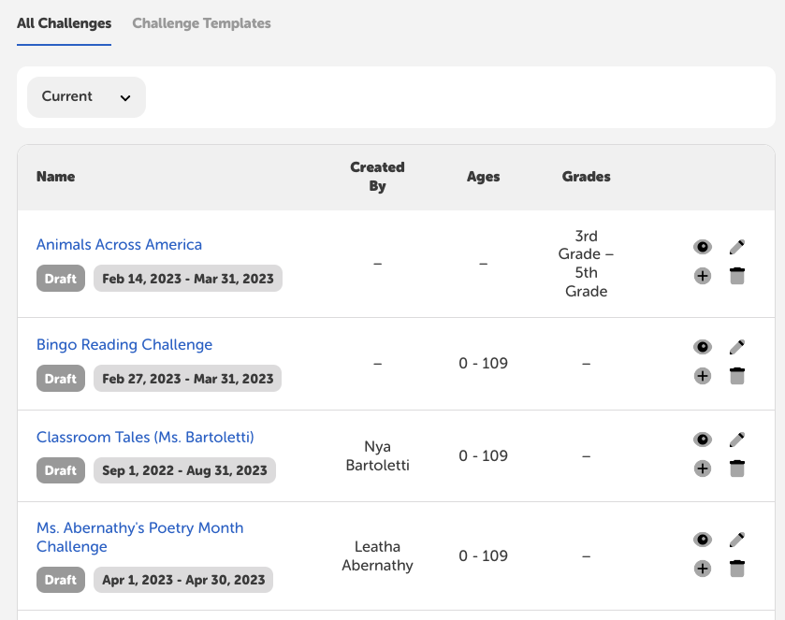
Teacher Challenges
Create a challenge specifically for their classroom(s)
View and duplicate challenges other teachers at their school have created
View data specific to their challenges

Slide 21
Teacher Experience Demo Video

Slide 22
Tips for Success

Slide 23
First:
Set a classroom goal
Recognize student achievements
Participate in grade level or class competitions
Utilize the launch kit + rollout guides

Slide 24
Then:
Incorporate free/inexpensive prizes
Collaborate with other teachers on curriculum-based reading list challenges
Promote on available channels (ClassDojo, Canvas, class newsletters, etc)

Slide 25
Help + Resources

Slide 26
Help at Your Fingertips
Beanstack Basics Video Library
Help Desk Wizard
Submit a Ticket
Short on-demand tutorials embedded in the dashboard and on the help desk
Browse comprehensive documentation on everything from challenge creation to running reports.
Can’t find the answers you’re looking for? Submit a support ticket for the fastest help.

Slide 27
Launch Resources
Check out these resources
Launch Kit
Student experience video
Teacher Experience video
Beanstack Helpdesk

Slide 28
Thank you!
elizabeth@beanstack.com

Slide 29
Additional Assets

Slide 30
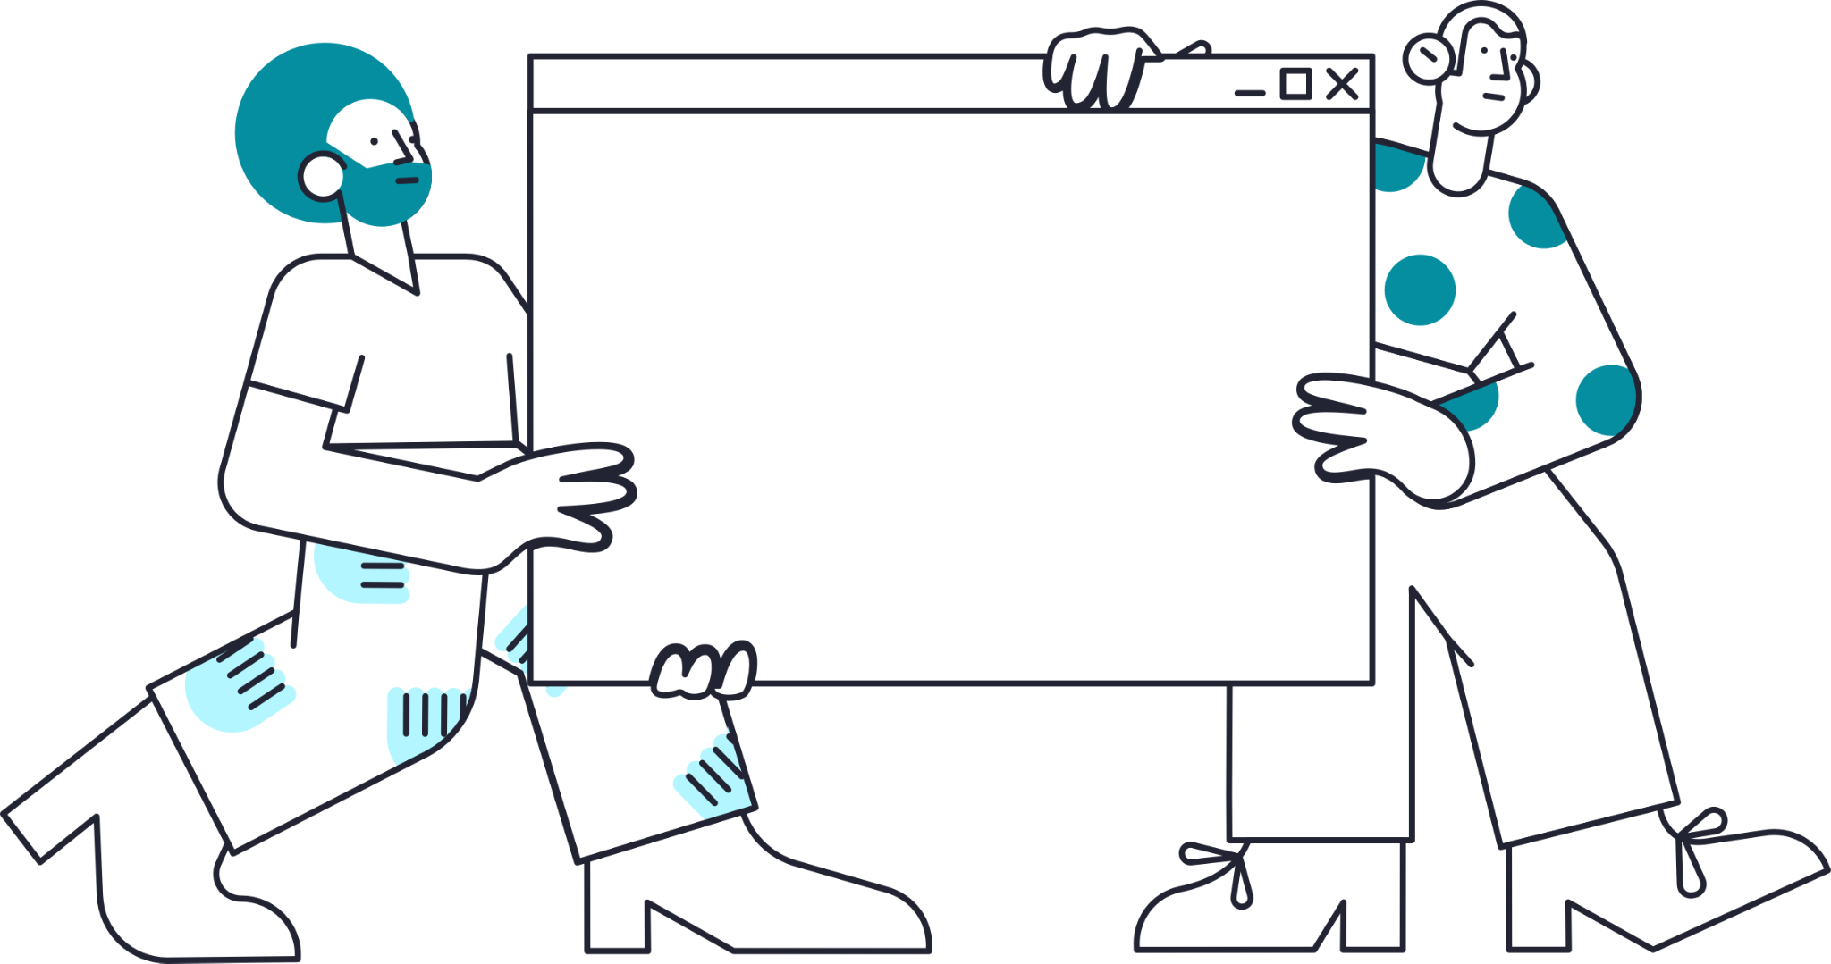
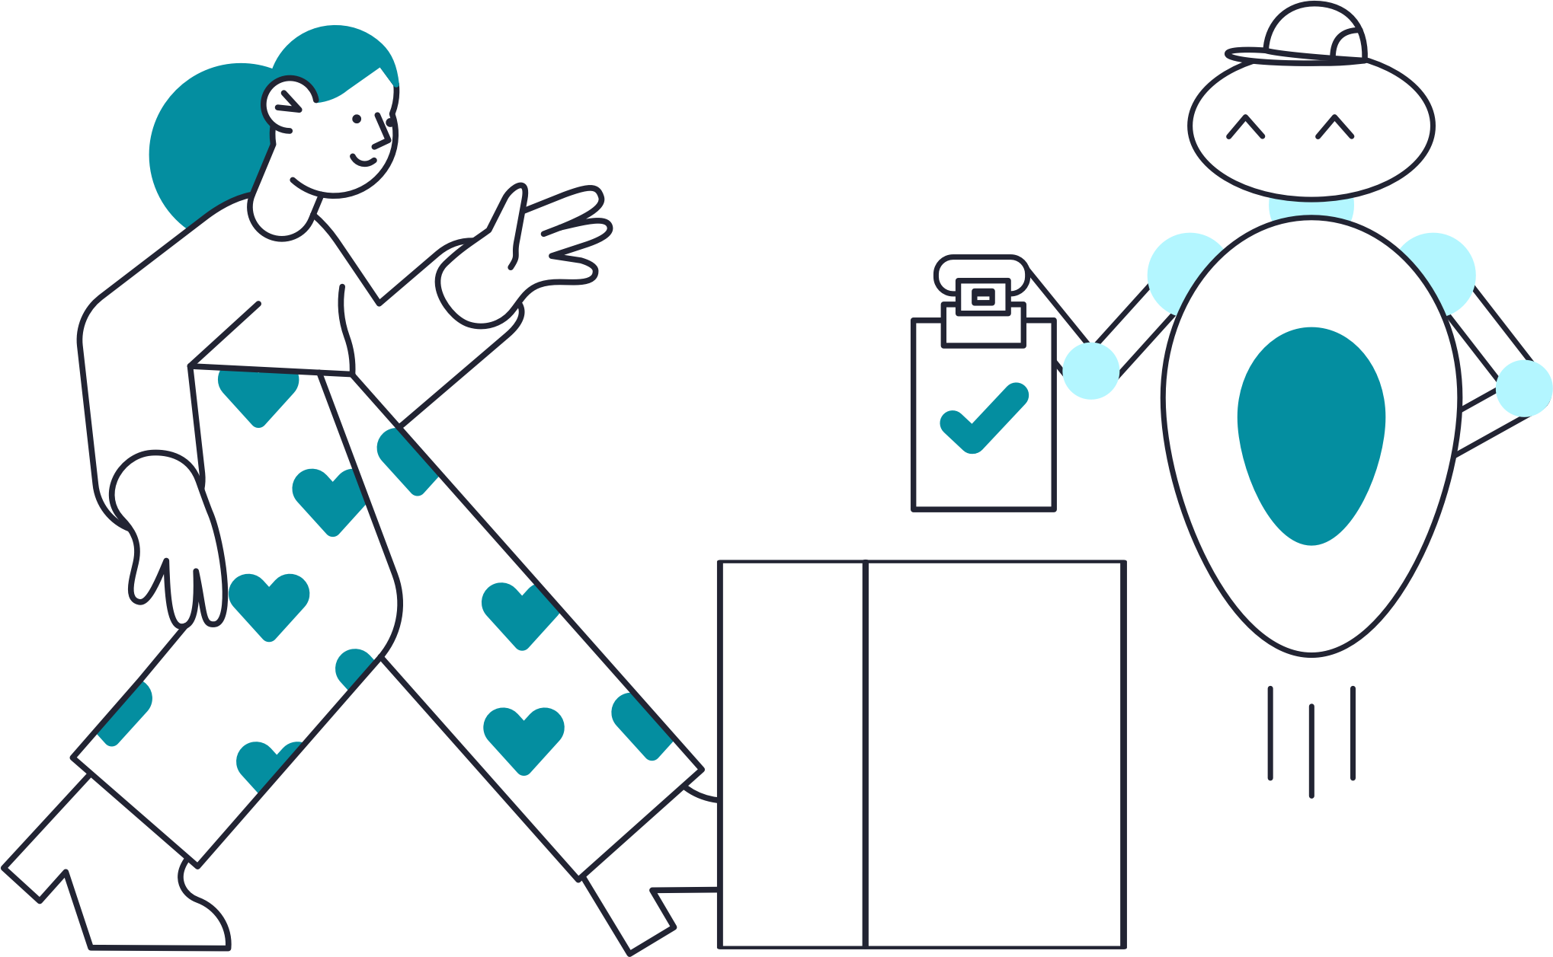

Slide 31
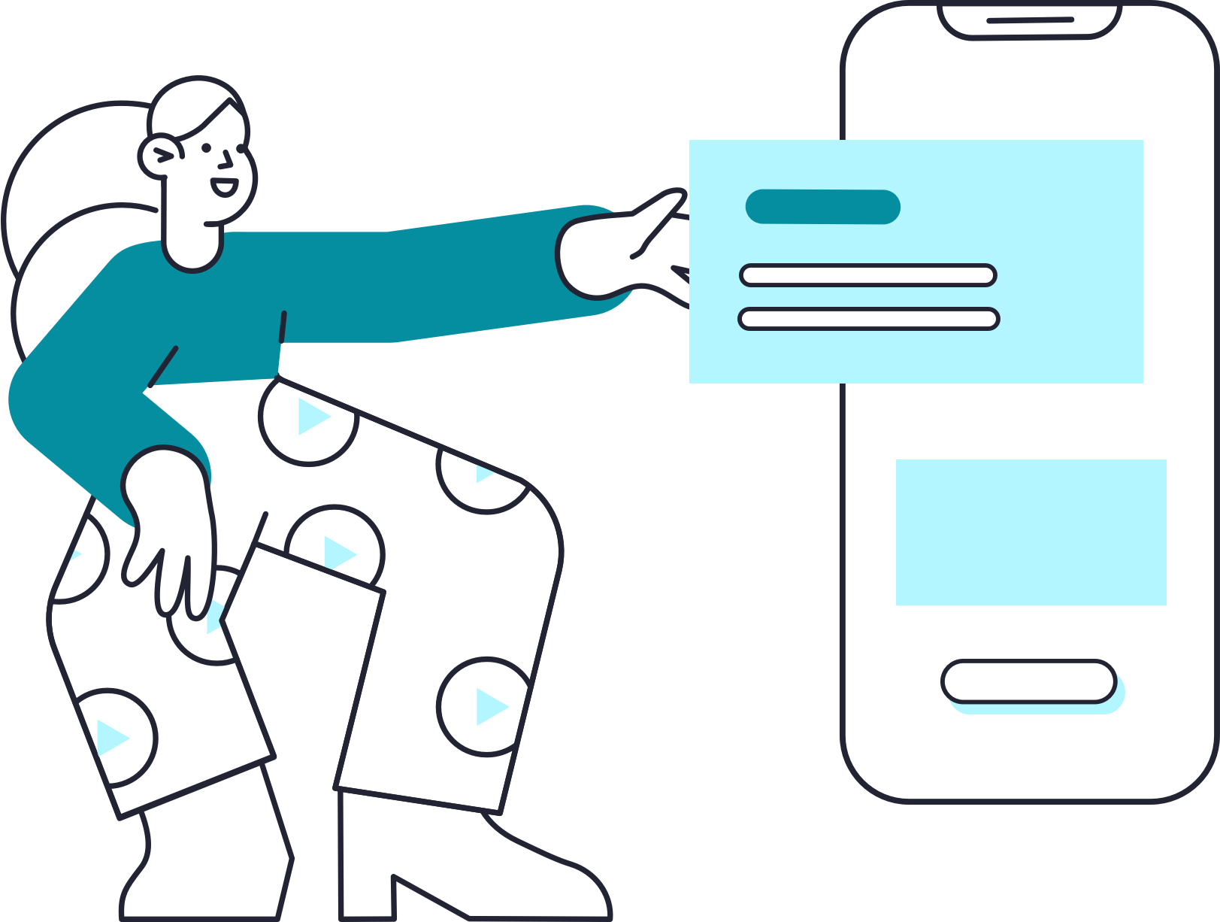
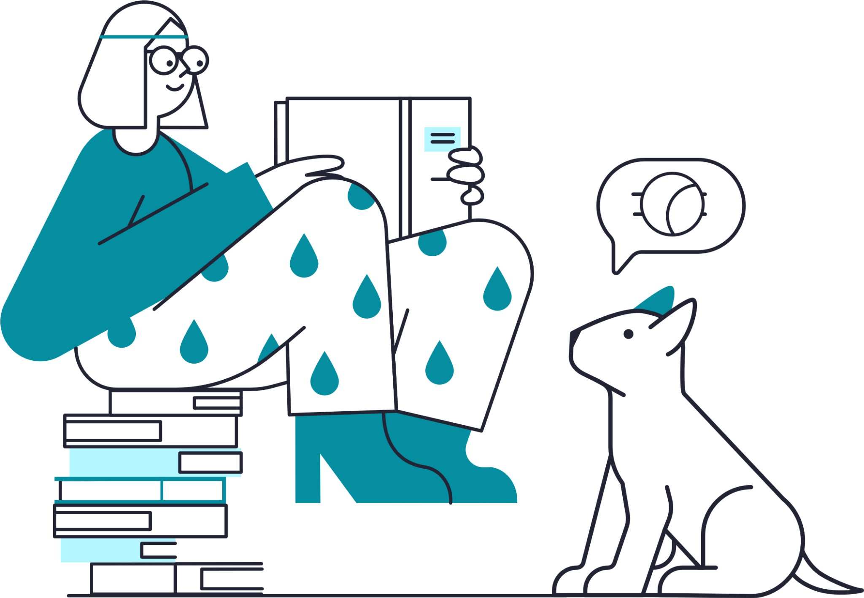
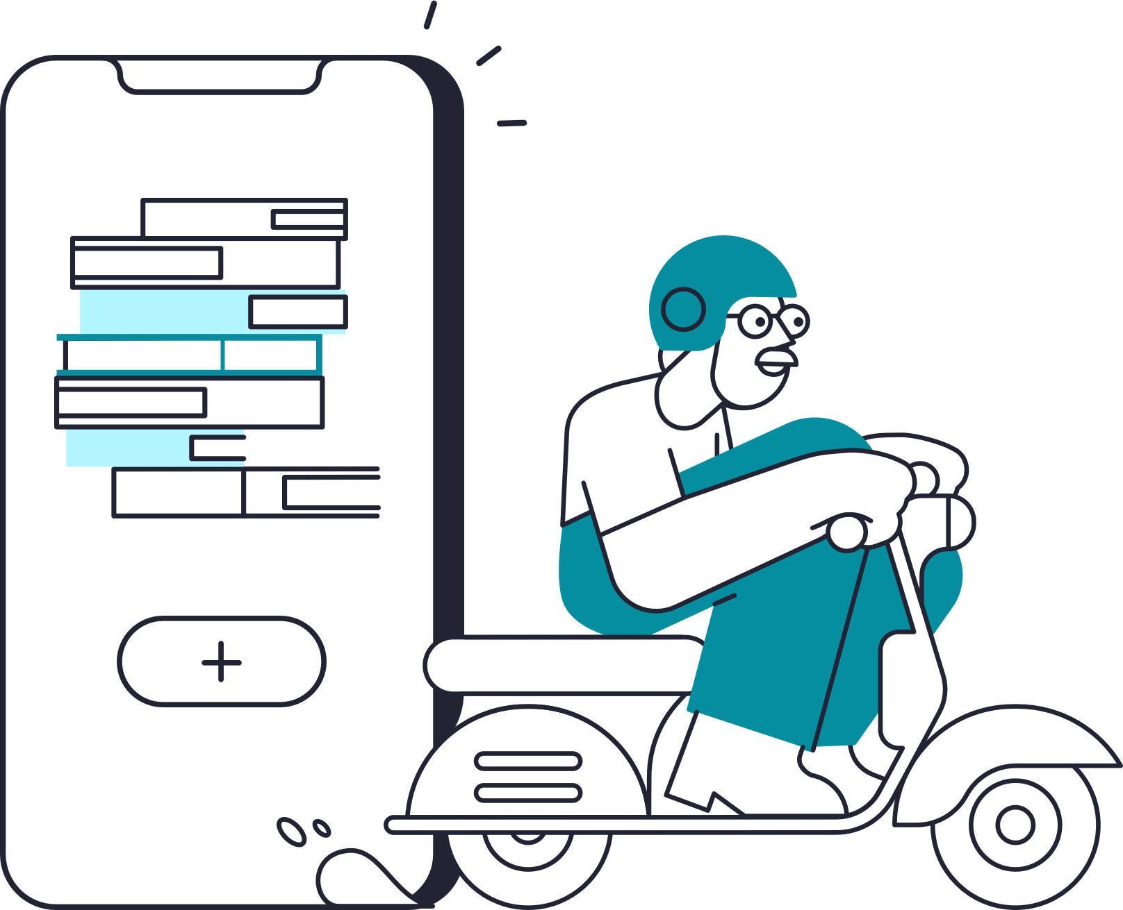

Slide 32
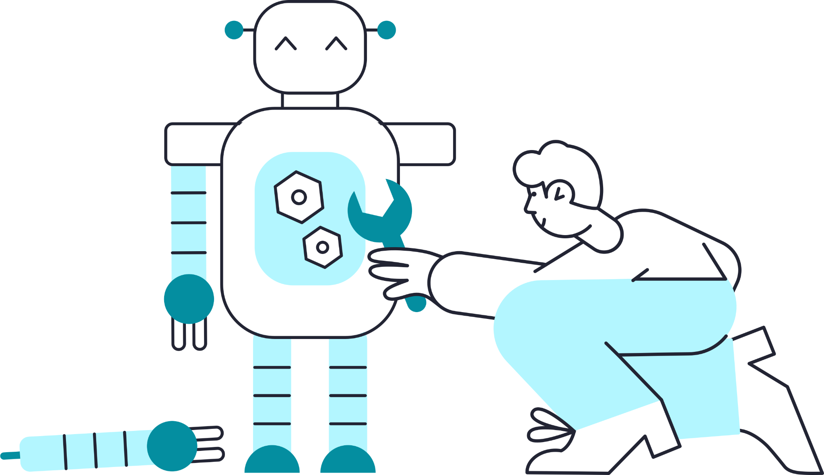

Slide 33
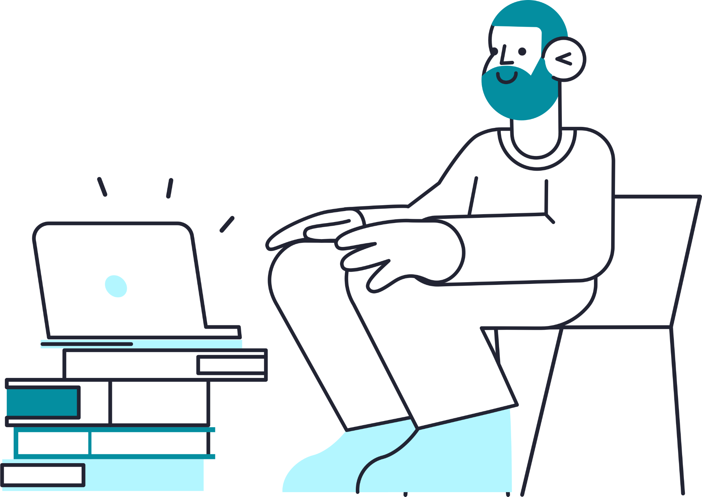

Slide 34
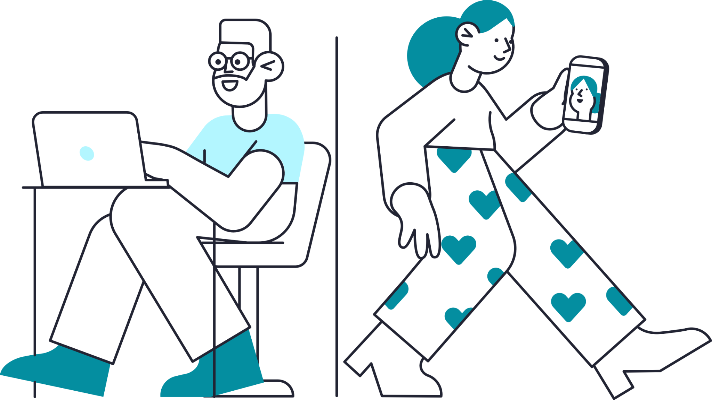

Slide 35
